Slide 1
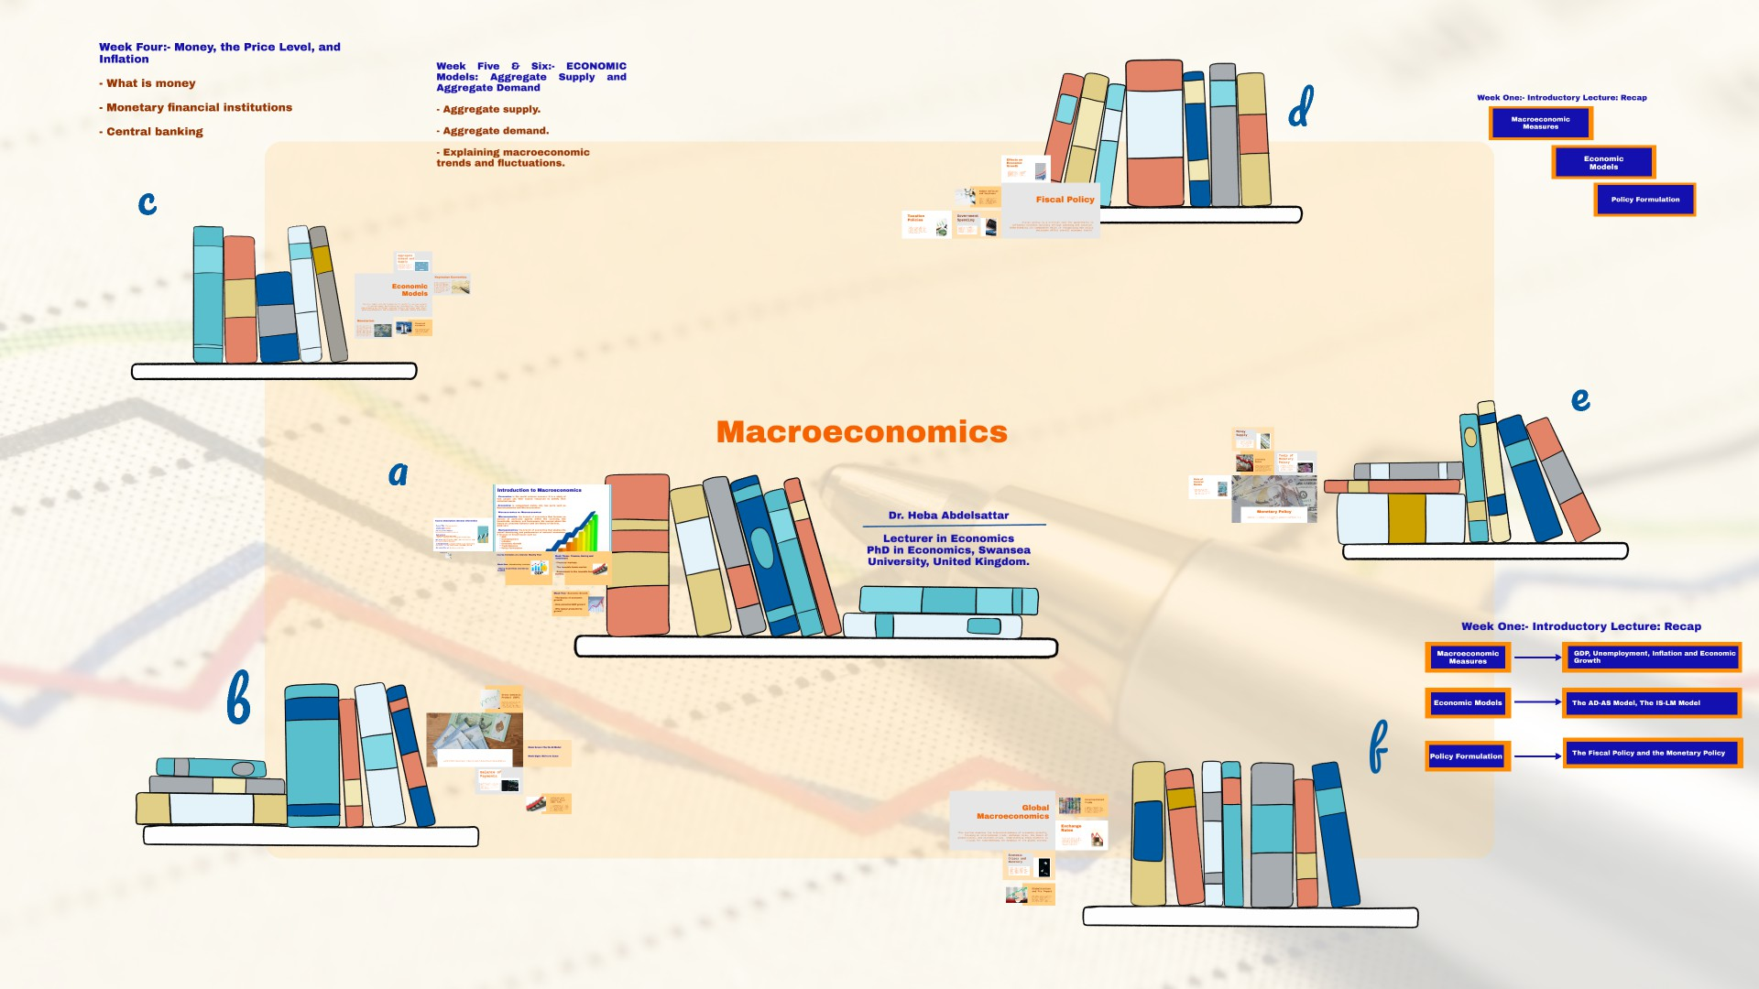

Slide 2


Slide 3


Slide 4


Slide 5
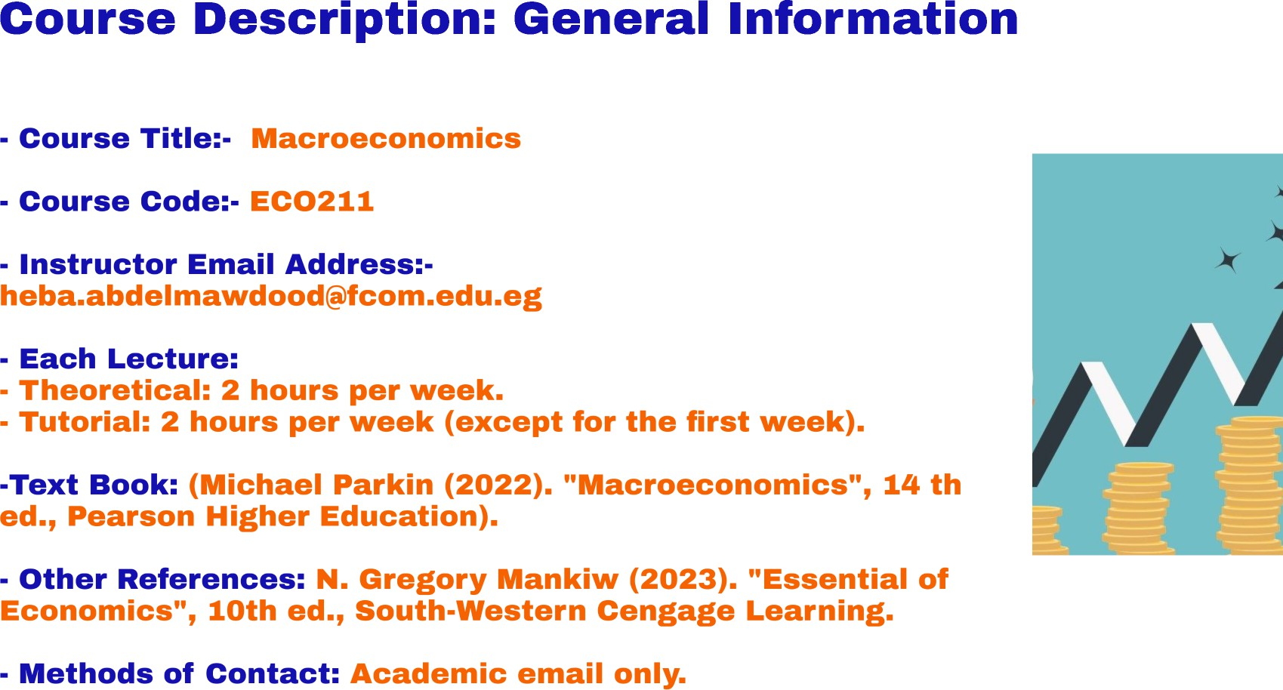

Slide 6
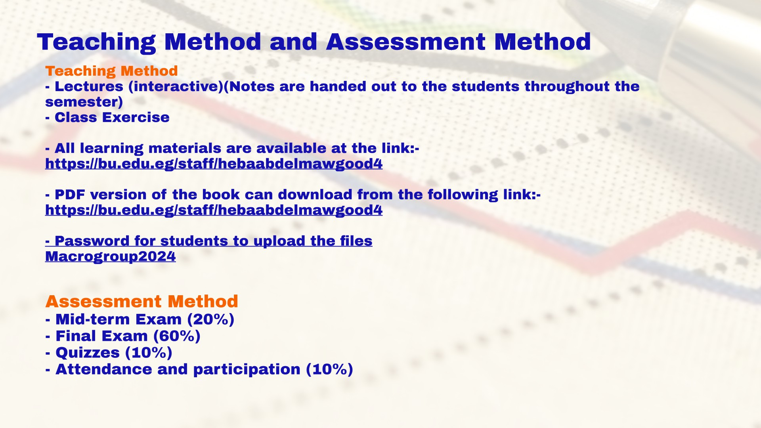

Slide 7
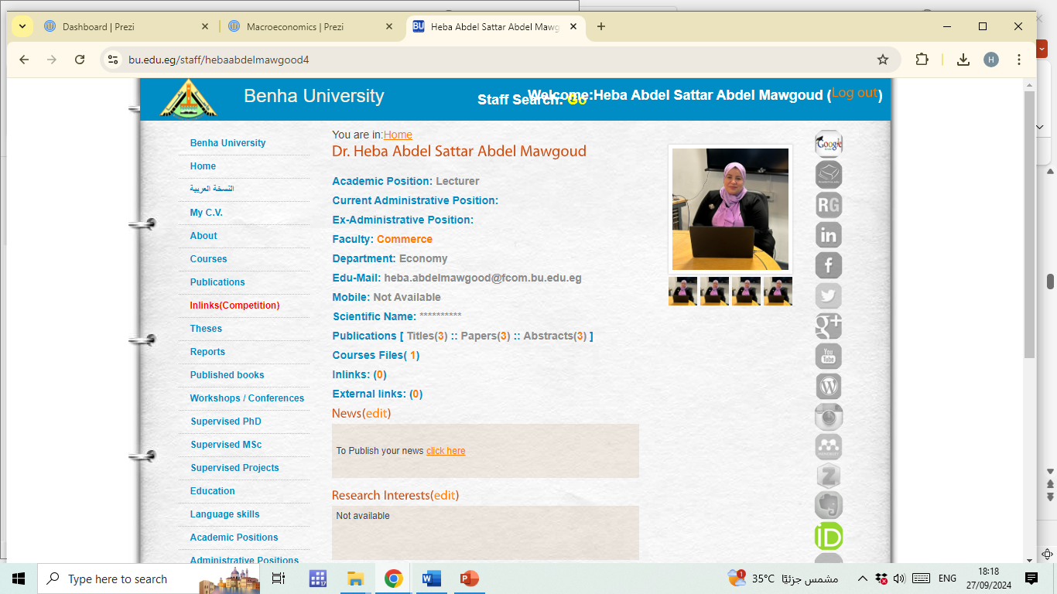

Slide 8
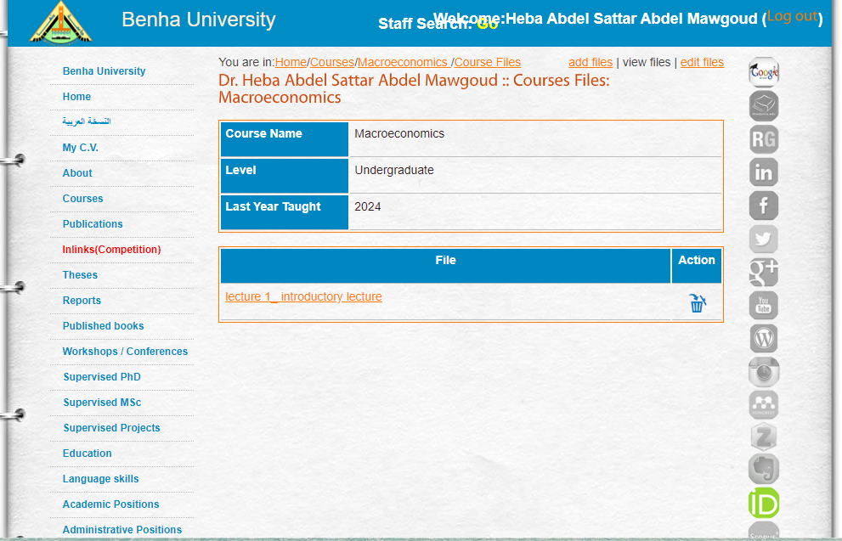

Slide 9
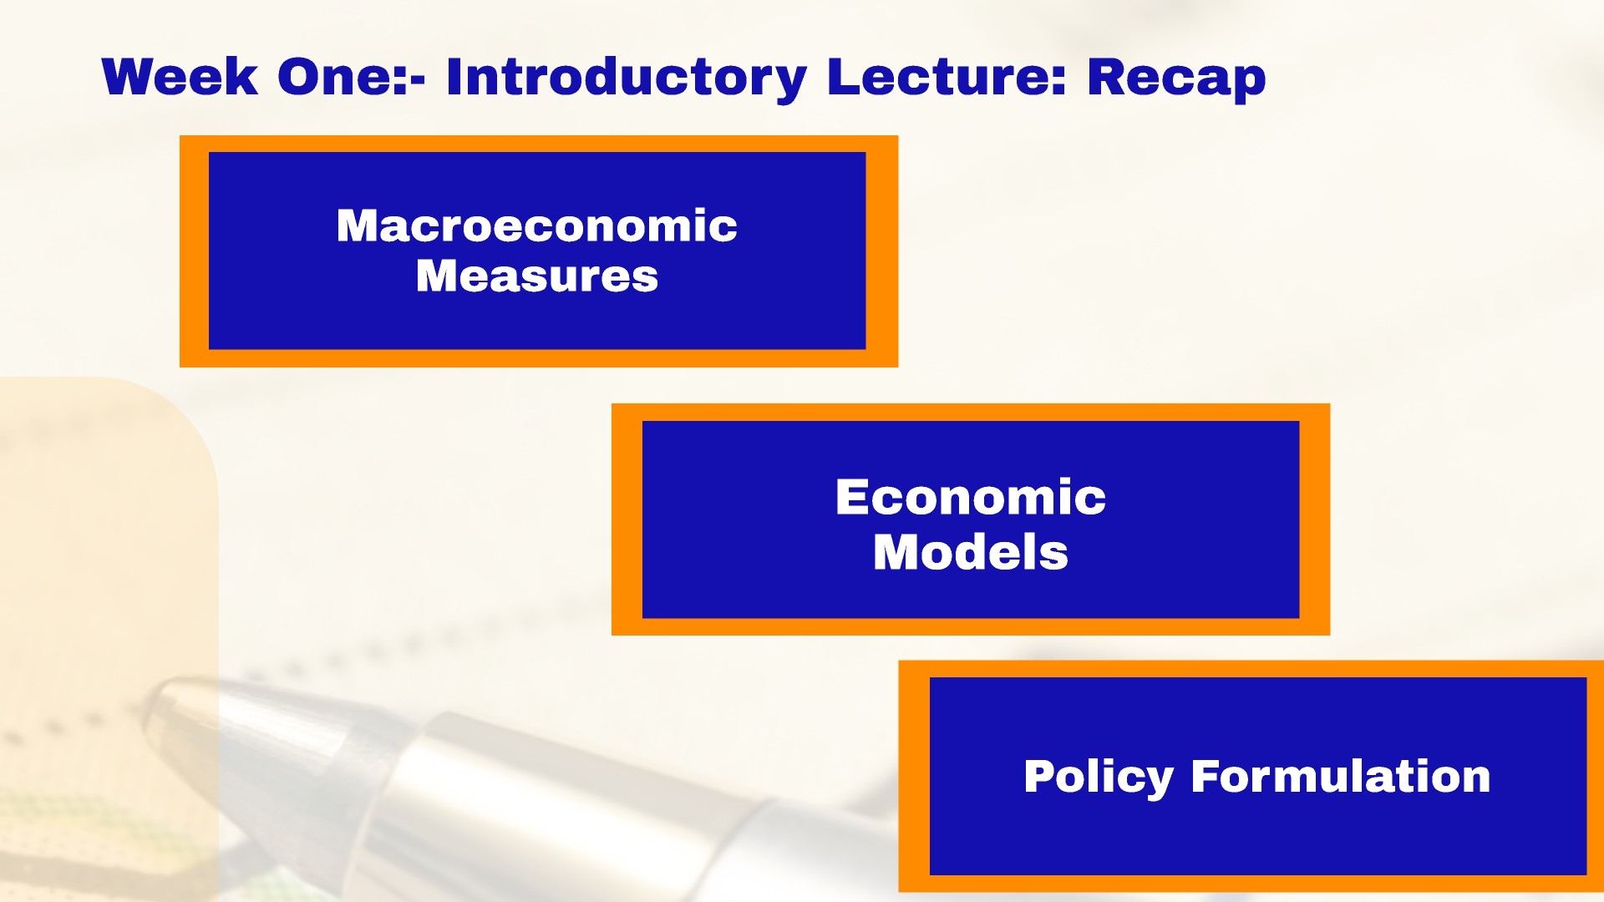

Slide 10
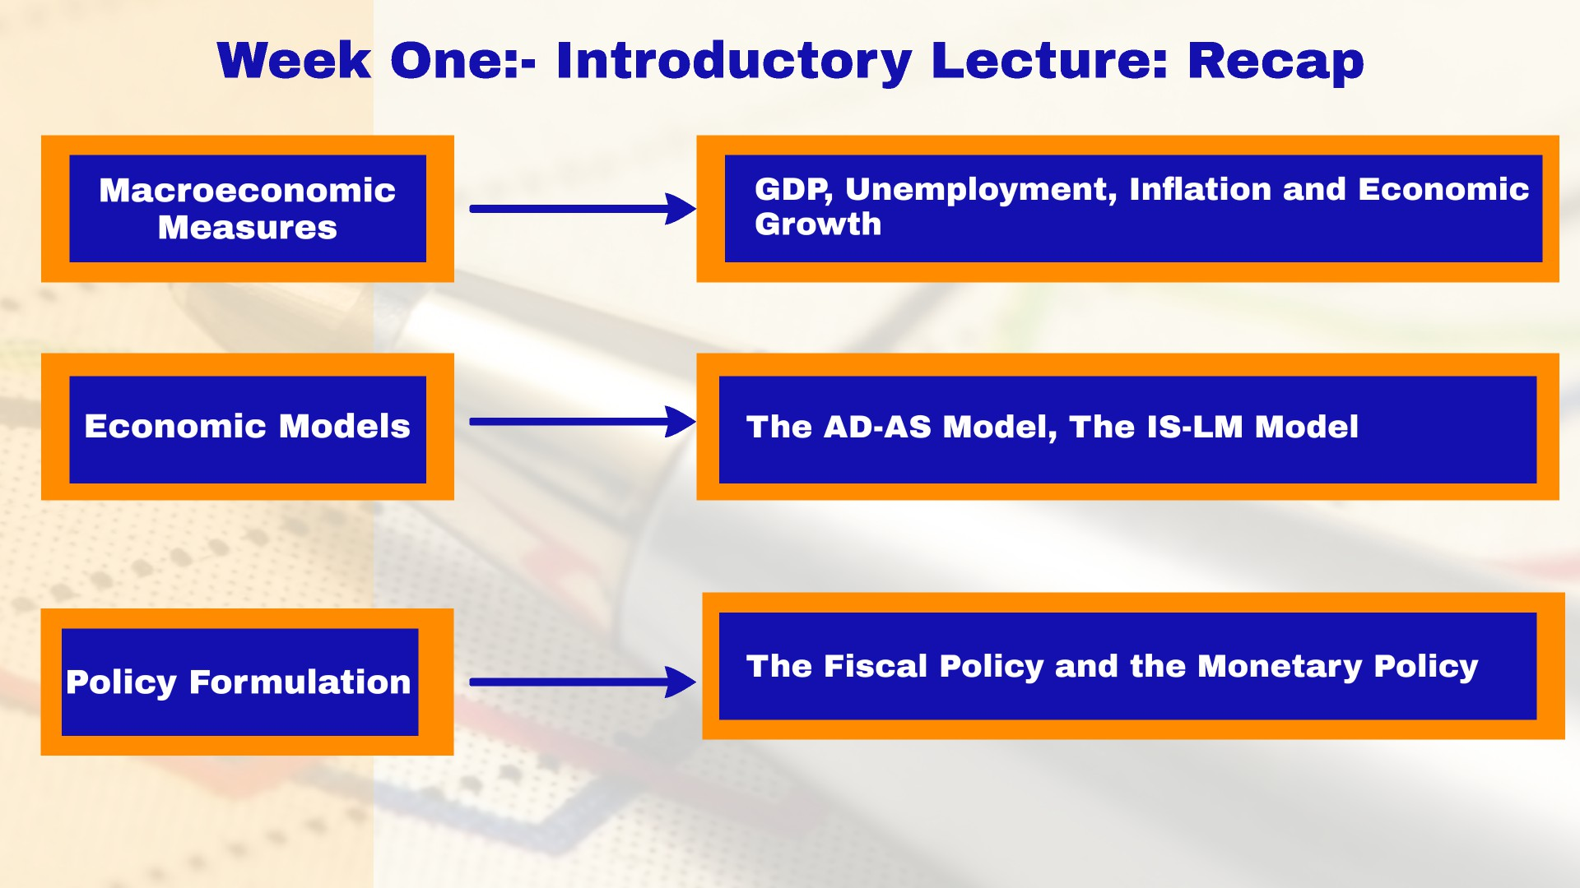

Slide 11


Slide 13


Slide 14
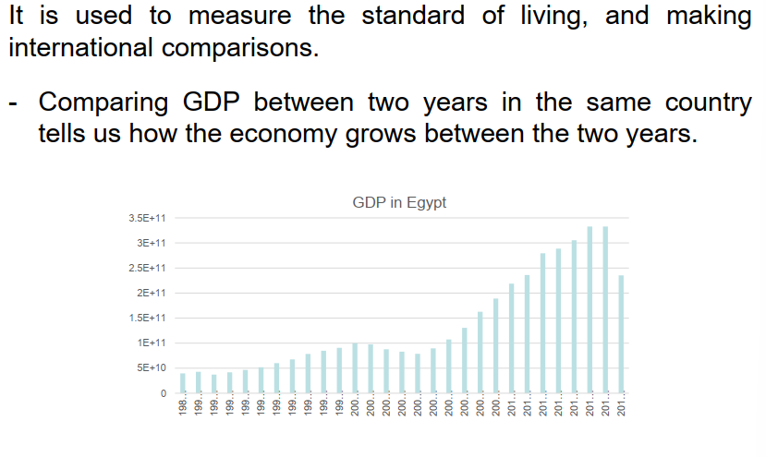
Gross Domestic Product (1) _____________
Dr.B.A.F Ch.21 Measuring GDP
14

Slide 15
Gross Domestic Product (2) _____________
GDP or gross domestic product is the market value of all final goods and services produced in a country in a given time period.
This definition has four parts:
1) Market Value: these prices reflect how much people are willing to pay for a good or services.
2) Final goods and services: Goods and services produced for final use.
3) Produced within a country: value of output produced by factors of production located within a country. A foreign firm like Etisalat producing in Egypt is counted in Egyptian GDP
4) In a given time period: GDP measures production during a specific time period, normally a year or a quarter of a year.
Dr.B.A.F Ch.21 Measuring GDP
15

Slide 16
2. Measurement of GDP (1) _____________________
Every payment (expenditure) by a buyer is at the same time a receipt (income) for the seller.
GDP
Expenditure Approach
Measures the total amount spent on all final goods and services during a given period.
GDP = C+I+G+(X-M)
Income Approach
Measures the income received by all factors of production in producing final goods and services.
Total Income = Rent + wage + interest + profit
GPD = i + p + r + w
16

Slide 17
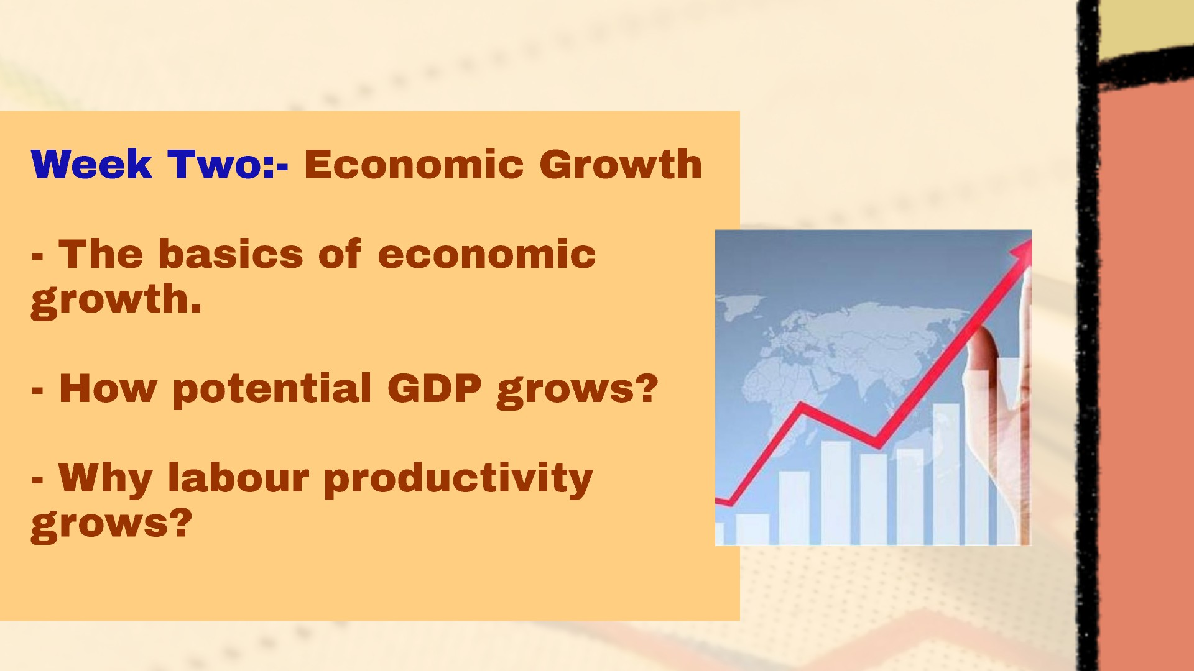

Slide 18
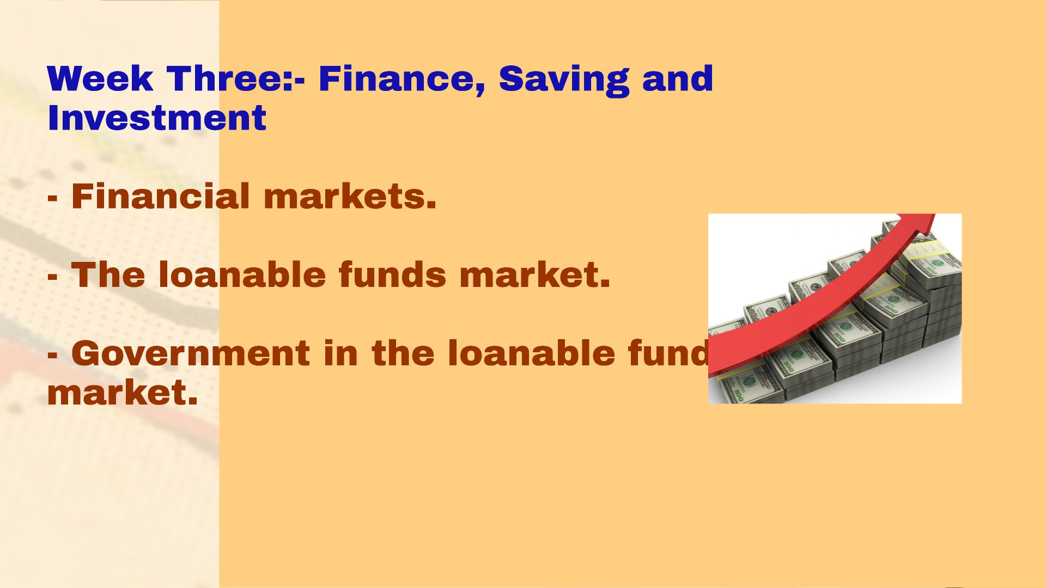

Slide 19
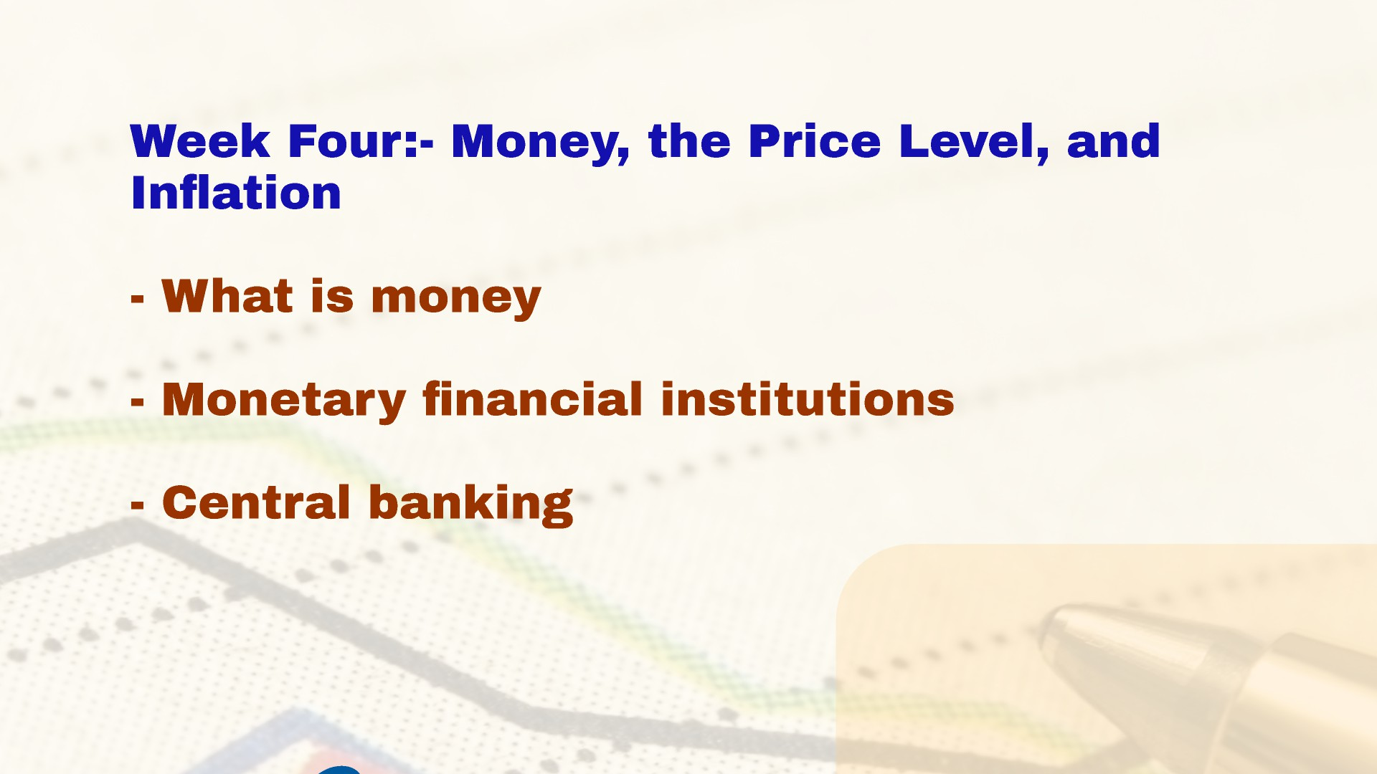

Slide 20
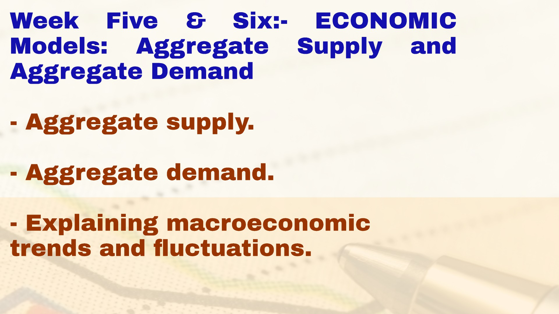

Slide 21
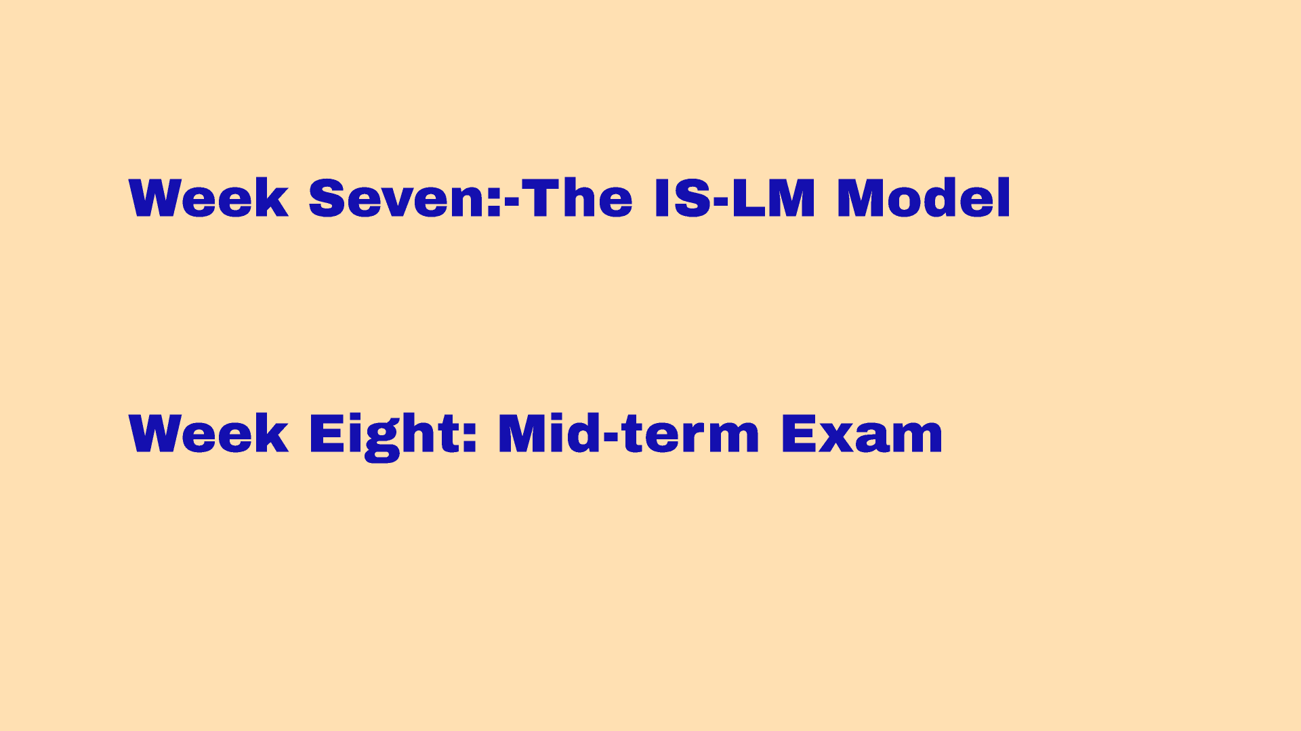

Slide 22


Slide 23


